Slide 1


Chapter 12
Maps, location, and
multimedia databases

Slide 2
Learning objectives
1. How to manage Handlebars documents through JavaScript programs
2. How to use maps in our app
3. How to use location information from our app
4. How to use Snap.js, Leaflet, and ESRI modules in our server-side code

Slide 3
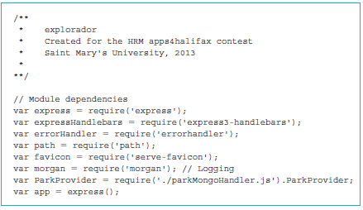
Setting up the environment in the Explorador app
The first step in getting our app going will be to launch the server with the app.js file.
Run the file using the command node app.js

Slide 4
Quick look
express: It is a basic framework to launch a web server that we have seen previously.
express3-handlebars: provides a Handlebars extension for the express server.
path: is a module that is used to set the location of files such as images.
serve-favicon: allows us to put an image in the URL window such as logo for our organization, when users come to our website.
morgan: used to maintain log of activities on the server.
parkMongoHandler.js: This is a module that we have written, to work with our MongoDB database.

Slide 5
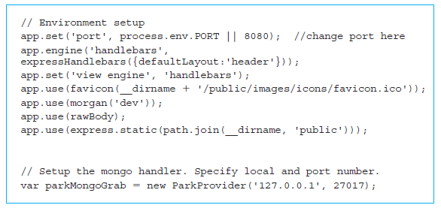
Setting up the environment in the Explorador app (cont’d)
The code that sets up the environment for the variable app

Slide 6
Setting up the environment in the Explorador app (cont’d)
The app.engine() method is used to specify the page rendering mechanism.
The app.set(‘view engine’, ‘handlebars’) will make sure that when express checks the view engine the string ‘handlebars’ is returned.
app.use(favicon(__dirname + '/public/images/icons/favicon.ico'))
app.use(express.static(path.join(__dirname, 'public')))
mentions that when express is looking for static files such as images, JavaScript, or stylesheets, they will be in the public directory.

Slide 7
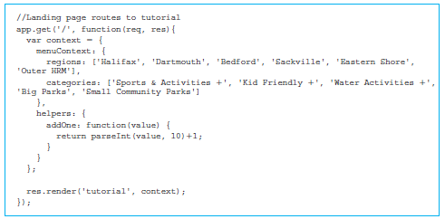
Specifying express routes
The JSON object is created at the beginning of the app.get() method. It specifies two name/value pairs:
The first pair is a JSON object itself, called menuContext, with two attributes. The first attribute is an array called regions, and the second attribute is an array called categories.
The second name/value pair, called helpers, specifies the function addOne that we use in the tutorial.handlebars to add one to an array index.

Slide 8
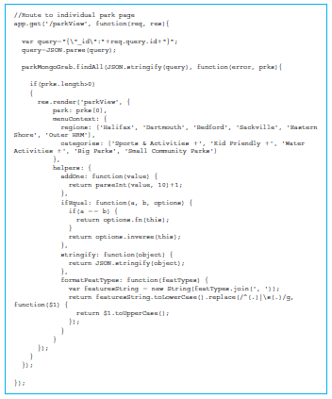
Specifying express routes (cont’d)
Using the app.get() method.
Create a JSON object called query.

Slide 9
Functions
ifEqual
stringify
formatFeatTypes

Slide 10
Specifying express routes (cont’d)
Handling the request http://140.184.132.239:8080/parkGrab
Using the function app.post().
Posts form data to the server.
Processing a parkGrab request in Explorador—I File: app.js
Creates two arrays
The first array is called regions and stores the names of all the regions.
The second array is called featTypes and stores the values of all the feature types our parks can have.

Slide 11
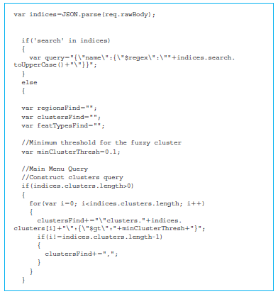
Processing a parkGrab request in Explorador—II File: app.js
An example of the MongoDB search query by name is:
{"name":{"$regex":"COMMONS"}}

Slide 12
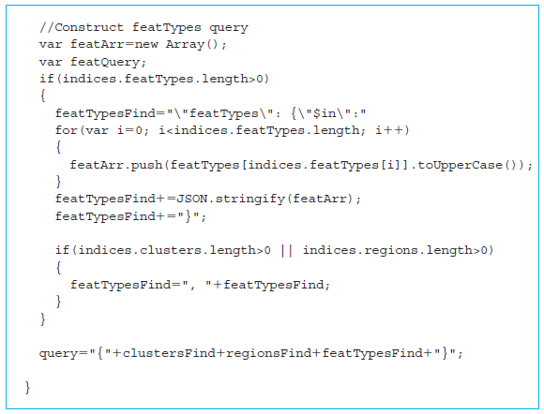
Processing a parkGrab request in Explorador—IV File: app.js

Slide 13

Querying MongoDB
Study how our Explorador app interacts with the MongoDB server, which contains all the data about parks.
Create variables for the required components of the MongoDB module using a series of calls to the require() method.
Db: Represents a MongoDB database as a JavaScript interface
Server: Represents a Server connection to the MongoDB database

Slide 14
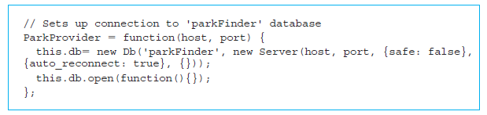
ParkProvider object constructor to connect to MongoDB File
The local machine IP address was specified, as well as the default port for MongoDB.
Using the provided host IP address and port, ParkProvider initializes a server connection to the database.
The database interface is provided with two parameters:
The name of the database containing all of our park data, called “parkFinder”
The server connection to MongoDB

Slide 15
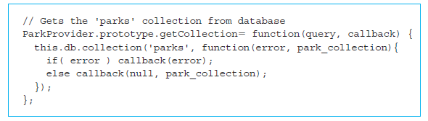
The code required for the function getCollection()
Code required for the function getCollection() takes two parameters: the query to run on the database as a string and a callback to run with either the results or an error.
This function is a wrapper around the MongoDB database function call to access a specific collection of documents.

Slide 16
Client-side JavaScript
menu.js
map.js
Initialization of many global variables that will be used by all functions in the menu.js file:
clustersQuery: An array of category (also called cluster) integers that the user has selected on the main menu. Indices match the cluster IDs stored in our database, values between 1 and 5 inclusive.
regionsQuery: An array of region indices that the user has selected from the main menu.

Slide 17
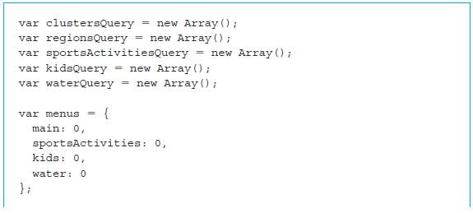
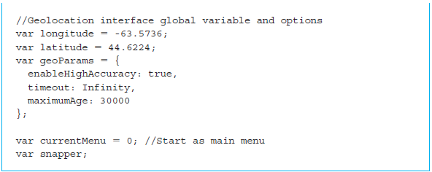
Client-side JavaScript (cont’d)

Slide 18
Client-side JavaScript (cont’d)
Allow users to specify more specifically which feature they are looking for in three of our categories, Sports and Activities, Kid Friendly features, and Water features.
sportsActivitiesQuery
kidsQuery
waterQuery
menus
longitude, latitude
geoParams
currentMenu
snapper

Slide 19
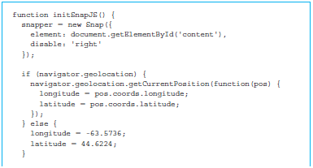
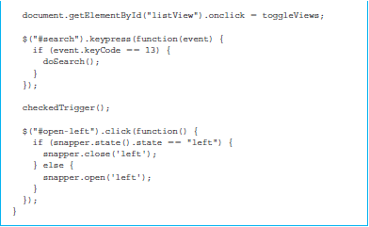
A key function in the application, initSnapJS()
Function creates a new instance of a Snap.js menu, where the main body, the object that will slide from side to side, is the element in our templates with the ID “content”.

Slide 20
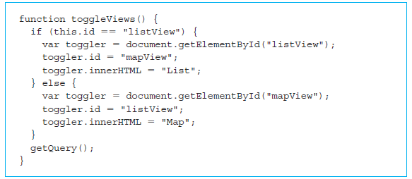
The function to be called by the span element
“this” is the object that was clicked and triggered the function, which in this case is the span element.
If it currently has the ID of “listView”, that means that results are currently being displayed in the list format.

Slide 21
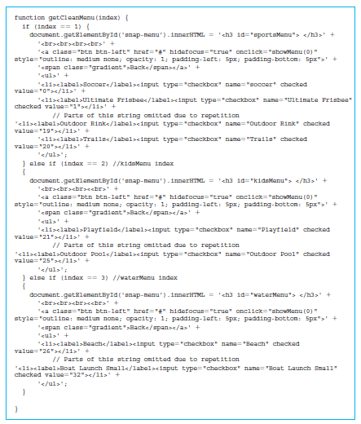
Setting submenus, getCleanMenu() File
The first time a given submenu is requested, this function sets the innerHTML of the menu to the string containing the HTML for a submenu in the default state, with all elements having been checked off.

Slide 22
Setting submenus, getCleanMenu() File (cont’d)

Slide 23
Two functions that manage user selections on the menu
checkedTrigger(): adds a function to each checkbox to handle the required functionality for our app.
lineItemButton(): checks that the <li> element does not contain an <input> element, then prevents other click functions from firing through the use of event.stopPropagation(), and then triggers the click function for that <li> elements checkbox.

Slide 24
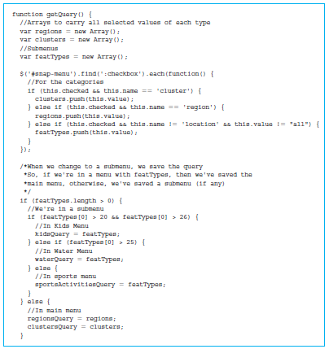
getQuery()
The key function for all the client-side code.
Gathers the selections the user has made from the menu and submenus and makes a request to the server for the relevant parks.

Slide 25
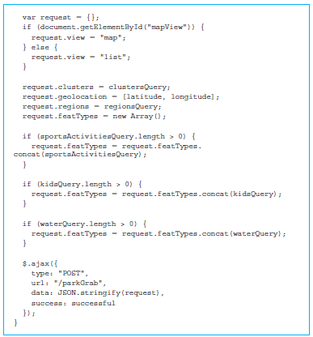
Constructing query JSON object to send to the server, getQuery()
Build up the request JSON object to send to the server.
This object will contain all of the desired parameters of the user’s request.

Slide 26
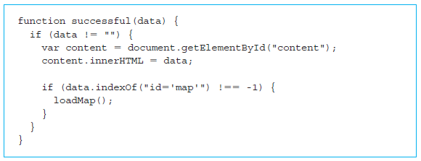
successful() function
Handles a successful response from the server.
First the function checks to ensure that the server has responded with some response data.

Slide 27
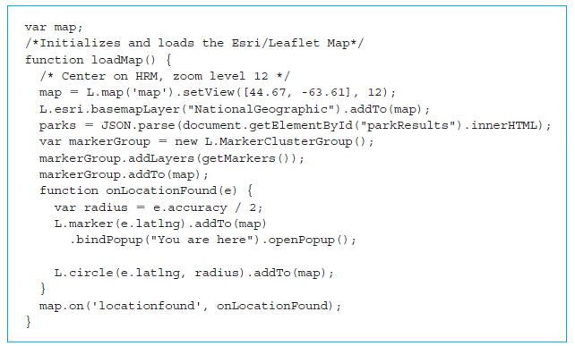
map.js
Map.js handles all of the logic required to load the map of Halifax and plot each of the parks on the map.
The map uses a combination of the open source Leaflet JavaScript library, http://leafletjs.com/ and the ESRI application programming interface (API), https://developers.arcgis.com/javascript/, for map image tiles.

Slide 28
getMarkers()
Obtain the HTML for all the markers to be plotted on the map and add them to our group of markers.
That set of markers is then added to the map.
An inline function is created onLocationFound() that will be run once the map finds the location of the user.
Leaflet accepts an array of markers to be plotted on the map.
The job of the getMarkers() function, is to convert the set of parks returned by the server as a JSON string to a set of markers.

Slide 29
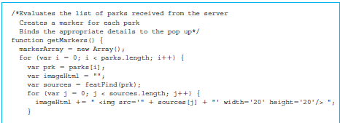
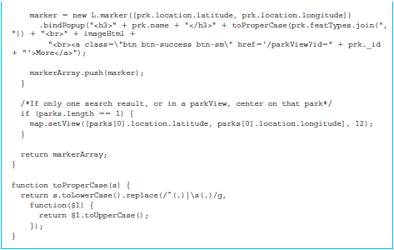
getMarkers() (cont’d)

Slide 30
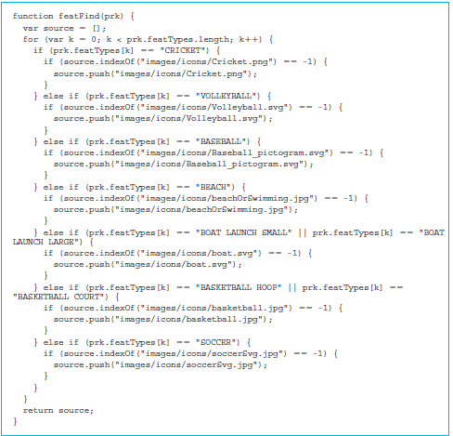
featFind function
The featFind function that iterates through all the features of a park, removes duplicates, and finds the corresponding path to icon images for those features.

Slide 31
Quick facts/buzzwords
path: A node.js module to set the location of static files such as images.
serve-favicon: A node.js module to put an icon next to the URL in the URL box of the browser.
morgan: A node.js module to maintain a log of activities on the server.
express routes: http requests sent to the express server.
regular expression: A language for specifying text patterns.
leaflet: An open source JavaScript library for map management.
ESRI: A geographical information system that provides an API for maps.

